Slide 1





Welcome to Bootcamp!
+
- YOUR FLIGHT PLAN TO SUCCESS -

Slide 2

What to Expect
This Bootcamp is designed to help you grow and accelerate your Microsoft Azure knowledge.
Over the next two days, you’ll receive:
Training sessions with Microsoft experts
Solution-focused technical labs
1-on-1 sessions with Pax8 engineers
120-day flight plan
Complimentary Wingman Professional Services from Pax8
+

Slide 3
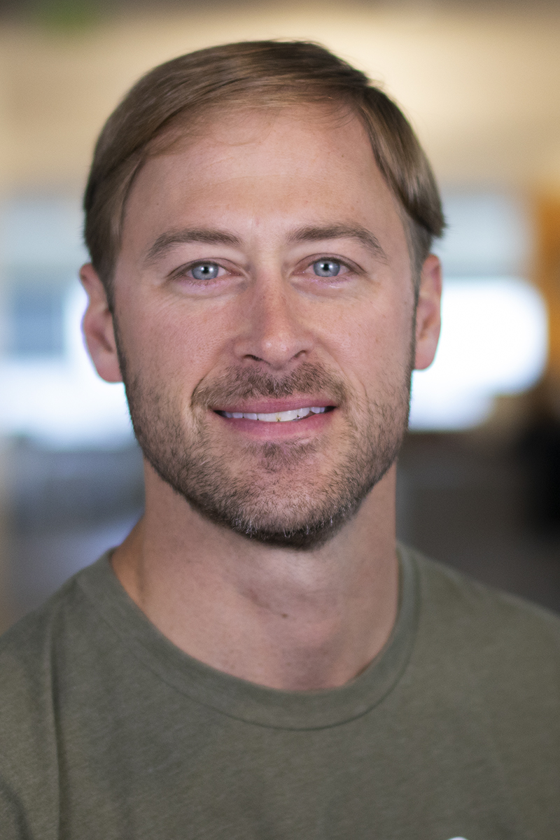

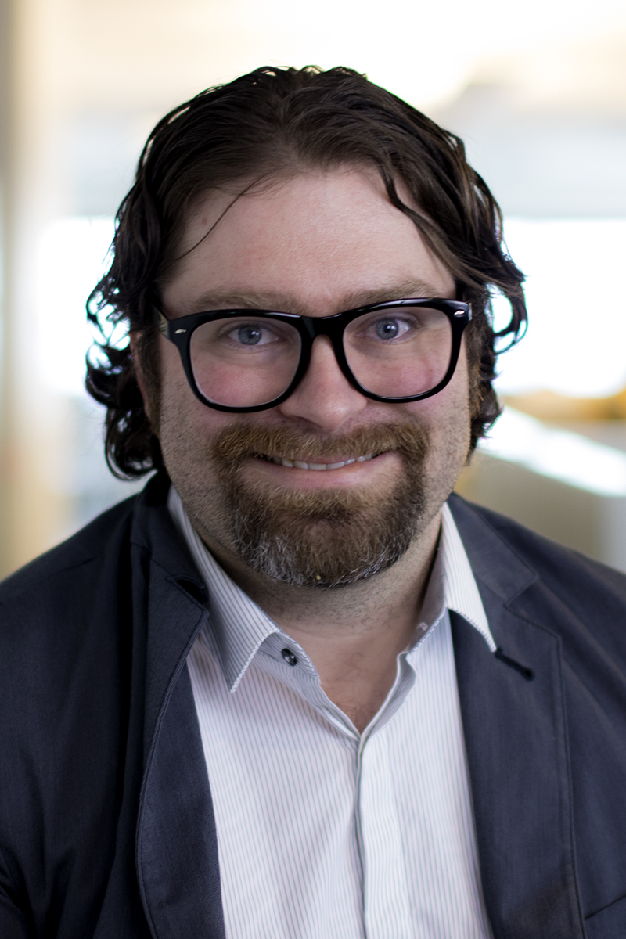
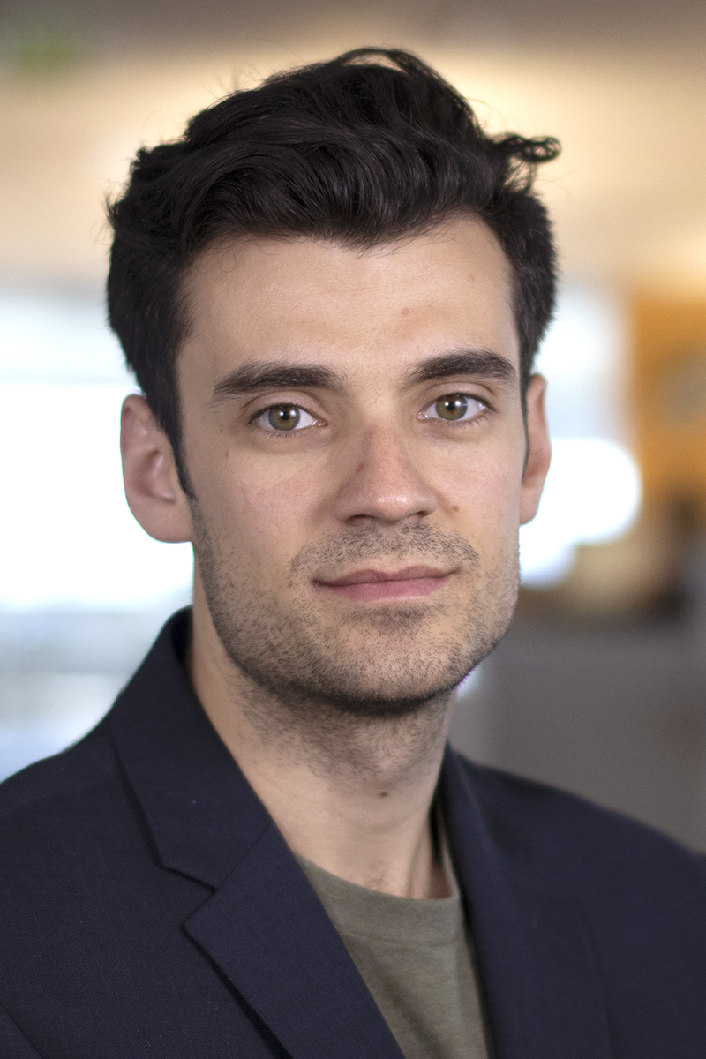

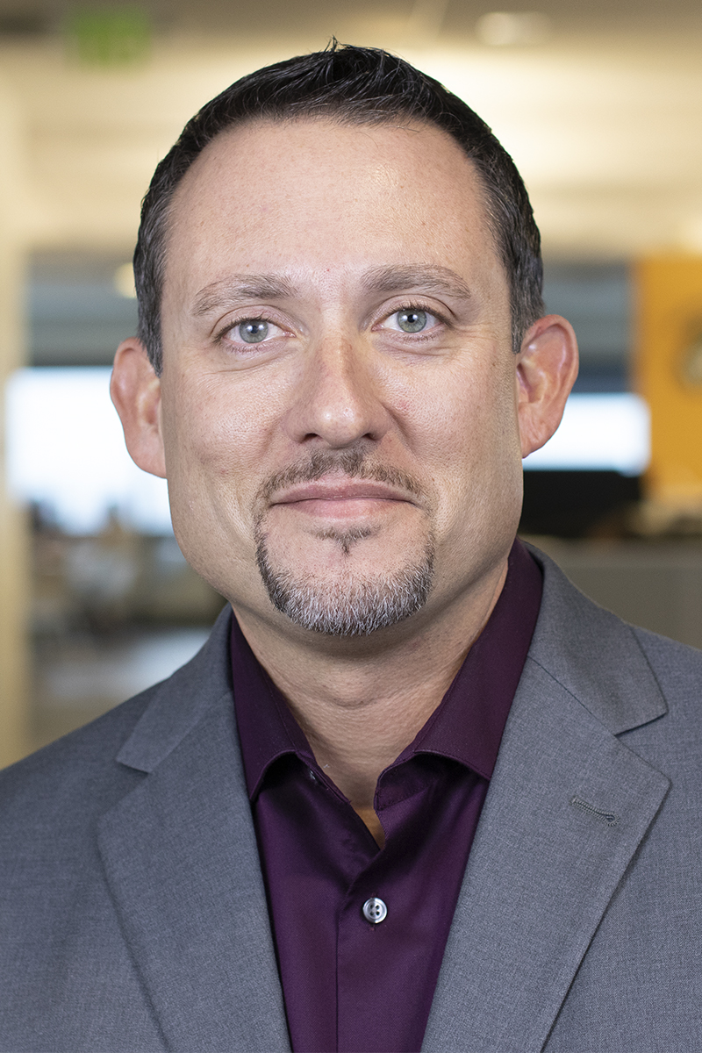
Meet the Engineers
Blake Closner
Aaron Garza
John Sonnier
Flavius Toma
Stephen Slattery
Ryan Hughes

Slide 4
Your Flight Plan to Azure
Our 3-phase approach is specifically designed for partners, no matter your Azure competency. During Bootcamp, Pax8 engineers will work one-on-one with you to cultivate any opportunities you have.
You bring the opportunities. We create your custom flight plan.
01. Runway
02. Take Off
03. Landing
The first step is to identify which of your applications or workloads can be moved to the cloud. The Pax8 partner-centric approach will help you gain expertise and knowledge, while you get comfortable navigating Azure.
Pax8 engineers will work with you to understand your client base and current configurations. Let us help create general architectures and cost models to get you familiar with the pricing structure. Focusing on teaching you how to position and sell Azure, we’ll define your targets, how to achieve them, and how to acquire new clients.
Once you’ve gained interest from your clients, work with Pax8 to schedule Azure training sessions for you and your clients, provide demos, discuss technologies, and give them exposure to the platform.
+

Slide 5
Agenda: April 17, 2019
DAY 1
8:00 – 9:00 | CHECK-IN & BREAKFAST
9:00 – 9:30 | Kickoff – Welcome & Intros
9:30 – 10:45 | Session 1: Hybrid Azure Strategy
10:45 – 11:00 | MORNING BREAK
11:00 – 12:00 | Session 2: Azure Infrastructure Overview
12:00 – 1:00 | LUNCH & Pax8 Demo: Windows Virtual Desktop ( w. Andy Green)
1:00 – 2:30 | Session 3: Azure Identity
1:00 – 4:00 | Pax8 Azure Engineers: 1-on-1 Time/120-Day Plans
2:30 – 4:00 | Session 4: Lab: Azure Identity
5:00 – 11:00 | PAX8 HAPPY HOUR + APPETIZERS
+

Slide 6
Agenda: April 18, 2019
DAY 2
8:00 – 8:30 | BREAKFAST
8:30 – 10:00 | Session 1: Pax8 Presentation: Getting started with quoting and designing your Azure environment
10:00 – 10:15 | Morning Break
10:15 – 11:30 | Session 2: Azure Cloud Backup & Azure Site Recovery
11:30 – 1:00 | LUNCH & Session 3: Lab Azure Backup
1:00 – 2:30 | Session 4: Azure Security & Management
1:00 – 5:00 | Pax8 Azure Engineers: 1-on-1 Time/120-Day Plans
2:30 – 4:00 | Session 4: Lab Azure Security Center
4:00 – 5:00 | Session 5: Azure Go-to-Market and Wrap Up
+

Slide 7
Wingman Professional Services
All Bootcamp attendees receive free Wingman Professional Services from Pax8.
Key Services:
White-glove email migrations
White-glove Azure migrations
AD Connect & AD Sync
Hardening Office 365
Custom projects
+
*Complimentary Professional Services will be available for Bootcamp attendees in the Pax8 Command Console*

Slide 8
Presentations and Labs
http://aka.ms/Pax8
+

Slide 9
+
Let’s Get Started!

